Slide 1
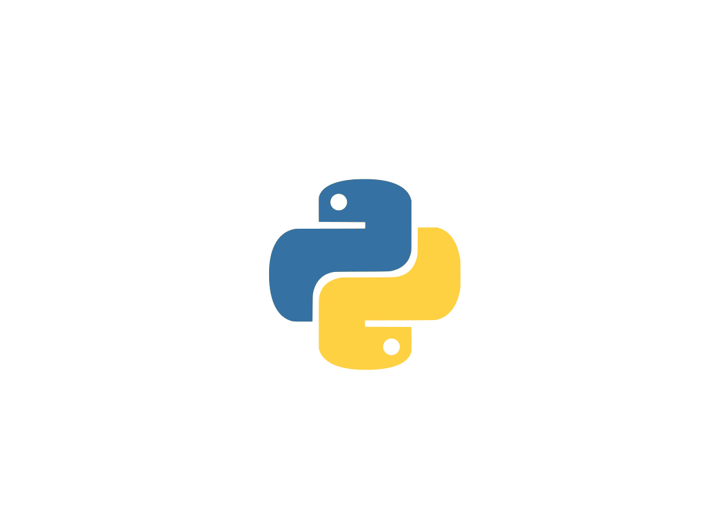
PYTHON
.

Slide 2
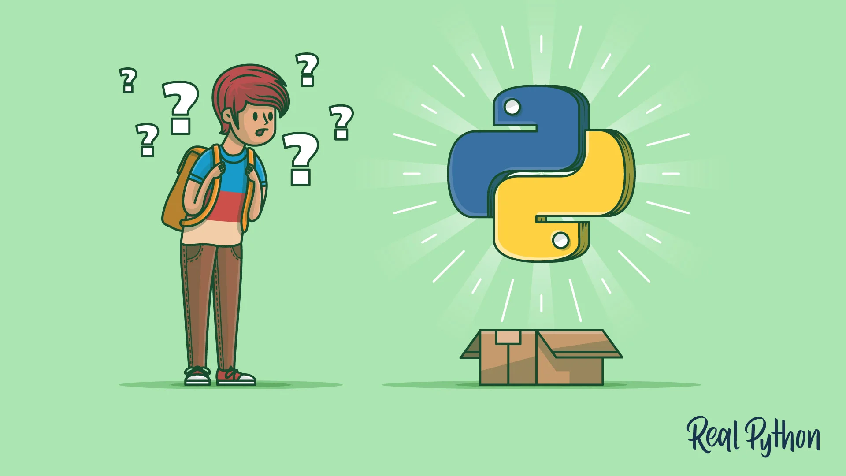
INTRODUCTION
PYTHON
Python is a general purpose , high level , and interpreted programming language known for its simplicity and readability.

Slide 3
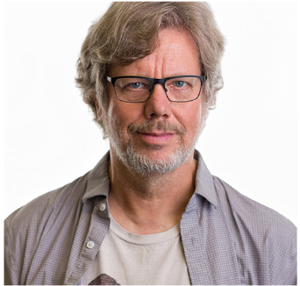
HISTORY OF PYTHON
Python was developed by Guido van Rossum in February 1991.
It was named after the British comedy show , Monty Python’s Flying Circus at the National Research Institute for Mathematics and Computer science in the Netherlands.
Further , it has since been developed by a large team of volunteers and is freely available from Python Software Foundation.
Python is derived from many other languages , including ABC,Modula-3,Unix shell ,etc…
GUIDO VAN ROSSUM

Slide 4
FEATURES OF PYTHON
1. EASY
Simple and easy to learn and code . It has very simple syntax.
2.EXPRESSIVE
Easy syntax and fewer syntactical constructions make python an expressive language.
3.FREE AND OPEN SOURCE
Python is free and open , as you can download and install without paying any fee.

Slide 5
..
4.PORTABLE
It is platform independent and can run on any platform without changing any changes to it.
5.EXTENSIBLE
It allows you to either add or modify syntax.
It is also embeddable.
..

Slide 6
APPLICATIONS OF PYTHON
Web and Internet Development:-
Python has a huge built-in library that supports internet protocols and offers many choices for web development.
Scientific and Numeric Computing:-
It has a huge library of mathematics and data analysis packages.
Desktop GUI’s:-
It is used to build desktop GUI’s and applications using various toolkits.
Software development
Business Applications
.

Slide 7
LIMITATIONS OF PYTHON
Python is interpreted and dynamically typed language . Code execution that is carried out line by line is often slow.
Python’s memory consumption is too high due to the flexibility of data types.
Sometimes , large organizations may not prefer Python to maintain their data records because its connectivity is not as efficient as compared to JDBC and ODBC.
.

Slide 8

.
.

